Slide 1
THEORY OF MARKET STRUCTURES

Slide 2
Theory Of Market Structures
Answers the following question –
How do firms decide their profit maximising outputs and prices?

Slide 3
Profit Maximization
Do firms maximize profits?
  Implications of non-profit objective
    Over the long-run investors would not support the company
    Without profits, survival unlikely
    YES
Notes:
6

Slide 4

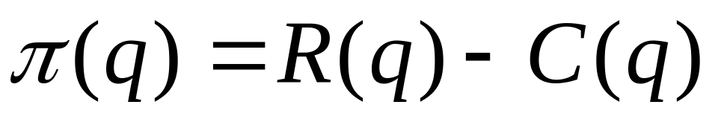
Marginal Revenue, Marginal Cost, and Profit Maximization
Determining the profit maximizing level of output
  Profit ( ) = Total Revenue - Total Cost
  Total Revenue (R) = Pq
  Total Cost (C) = cq
  Therefore:
Notes:
8

Slide 5
Profit Maximization in the Short Run
Cost,
Revenue,
Profit
(Rs per year)
Total Revenue
R(q)
Slope of R(q) = MR
0
Output (units per year)
Notes:
10

Slide 6
Profit Maximization in the Short Run
C(q)
Cost,
Revenue,
Profit
Rs (per year)
Total Cost
Slope of C(q) = MC
0
Output (units per year)
Notes:
11

Slide 7
Marginal Revenue, Marginal Cost, and Profit Maximization
Marginal revenue is the additional revenue from producing one more unit of output.
Marginal cost is the additional cost from producing one more unit of output.
Notes:
14

Slide 8

Marginal Revenue, Marginal Cost, and Profit Maximization
MC,
MR
MC
Comparing R(q) and C(q)
  Output levels: 0 - q₀
    - C(q)> R(q)
    - Negative profit
    - MR > MC
    Indicates higher profit
    at higher output
MR
q₀
q*
C(q)
Cost,
Revenue,
Profit
(Rs per year)
A
R(q)
B
  - Output levels: q₀ - q*
    - R(q)> C(q)
    - MR > MC
    - Indicates higher profit at
      higher output
      - Profit is increasing
0
q₀
q*
Output (units per year)
Notes:
16

Slide 9
Marginal Revenue, Marginal Cost, and Profit Maximization
MC
MR
MC
MR
Cost,
Revenue,
Profit
Rs (per year)
q₀
q*
output
Comparing R(q) and C(q)
  Output level: q*
    - R(q) > C(q)
    - MR = MC
    - Profit is maximized
C(q)
A
R(q)
B
  - Output levels beyond q* :
  - R(q)> C(q)
    - MC > MR
    - Profit is decreasing
0
q₀
q*
Output (units per year)
Notes:
22

Slide 10
Marginal Revenue, Marginal Cost, and Profit Maximization
MC
MR
MC
MR
Cost,
Revenue,
Profit
Rs (per year)
q₀
q*
output
C(q)
Therefore, it can be said:
  Profits are maximized when MC = MR.
A
R(q)
B
0
q₀
q*
Output (units per year)
Notes:
22

Slide 11
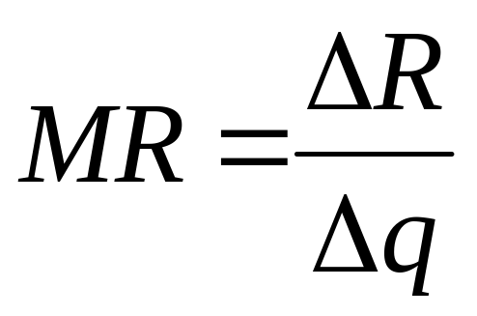
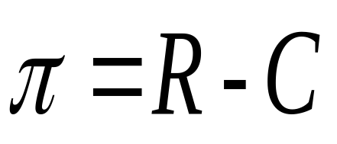
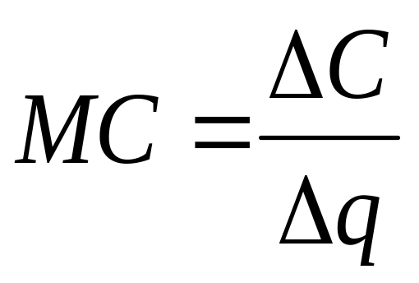
Marginal Revenue, Marginal Cost, and Profit Maximization
Notes:
23

Slide 12
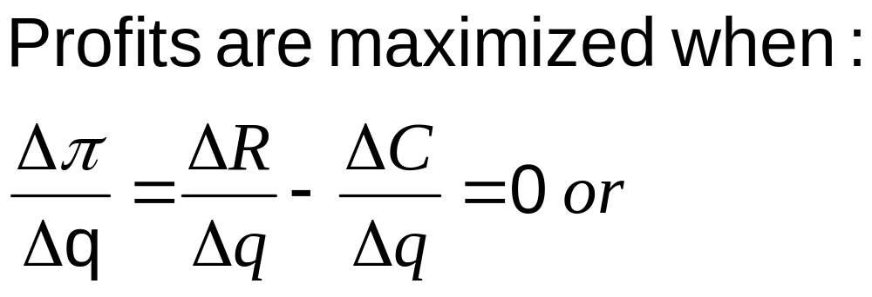
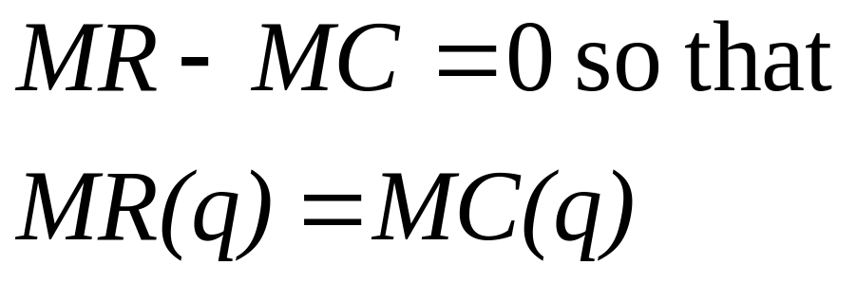
Marginal Revenue, Marginal Cost, and Profit Maximization
Notes:
24

Slide 13
The Degree of Competition
Classifying markets
  number of firms
  freedom of entry to industry
  nature of product
  nature of demand curve
The four market structures
  perfect competition
  monopoly
  monopolistic competition
  oligopoly

Slide 14
The Four Market Structures
Two Extremes
Perfect
Competition
Monopolistic
Competition
Oligopoly
Monopoly
Market Structure Continuum

Slide 15
Firms In Perfectly Competitive Markets

Slide 16
WHAT IS A COMPETITIVE MARKET?
A perfectly competitive market has the following characteristics:
  There are many buyers and sellers in the market.
  The goods offered by the various sellers are homogenous.
  Firms can freely enter or exit the market.

Slide 17
WHAT IS A COMPETITIVE MARKET?
As a result of its characteristics, the perfectly competitive market has the following outcomes:
Price Taking
  The actions of any single buyer or seller in the market have a negligible impact on the market price since there are a large number of them selling identical products.
  Each buyer and seller takes the market price as given.
  Buyers and sellers must accept the price determined by the market.

Slide 18
WHAT IS A COMPETITIVE MARKET?
Product Homogeneity
  The products of all firms are perfect substitutes.
  Examples
    Agricultural products, vegetables, milk, fruits, lumber markets, stock market etc. approximate the perfectly competitive market structure.
Notes:
4

Slide 19
WHAT IS A COMPETITIVE MARKET?
Free Entry and Exit
  Buyers can easily switch from one supplier to another.
  Suppliers can easily enter or exit a market.
- In the short-run, firms may earn economic
profits or losses.
- Long-run economic profits are zero.
Notes:
4

Slide 20
Perfect Competition
Unrealistic? Why Learn?
Many small businesses are “price-takers,” and decision rules for such firms are similar to those of perfectly competitive firms.
It is a useful benchmark, since it benefits consumers, prevents their exploitation.
Explains why governments oppose monopolies.
Brings out the importance of product differentiation.

Slide 21
P.Compt As Per Supreme Court
“The main objective of the Competition Law is to promote economic efficiencies using competition as one of the means of assisting the creation of market responsive to consumer preferences.”
Judgment by the Hon'ble Supreme Court in Civil Appeal No. 7999 of 2010 pronounced on 9th September, 2010
The advantages of perfect competition are three-fold: allocative efficiency, which ensures the effective allocation of resources, productive efficiency, which ensures that costs of production are kept at a minimum and dynamic efficiency, which promotes innovative practices.
(Judgment by the Hon'ble Supreme Court in Civil Appeal No. 7999 of 2010 pronounced on 9th September, 2010)

Slide 22
The Revenue Of A Competitive Firm
Total revenue for a firm is the selling price times the quantity sold.
TR = (P × Q)
Total revenue is proportional to the amount of output.

Slide 23
The Revenue Of A Competitive Firm
Average revenue tells us how much revenue a firm receives for the typical unit sold.
Average revenue is total revenue divided by the quantity sold.

Slide 24
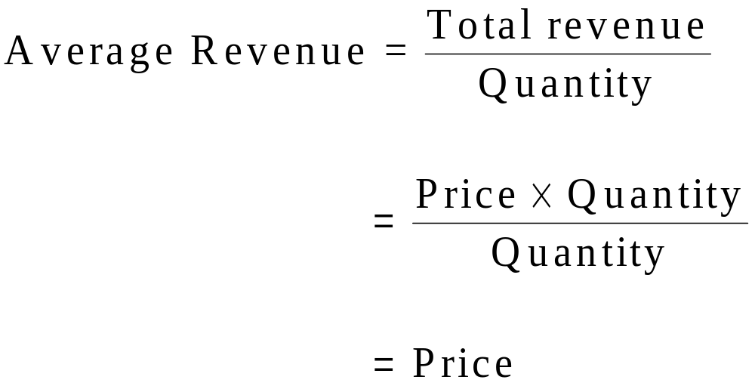
The Revenue Of A Competitive Firm
Average revenue equals the price of the good.

Slide 25
The Revenue Of A Competitive Firm
Marginal revenue is the change in total revenue from an additional unit sold.
MR =ΔTR/ ΔQ
For competitive firms, marginal revenue equals the price of the good.

Slide 26
TR, AR And MR For A Perfectly Competitive Firm
TR = (P × Q); AR = P; MR = P
TR
AR,
MR
TR
AR/MR
output
output

Slide 27
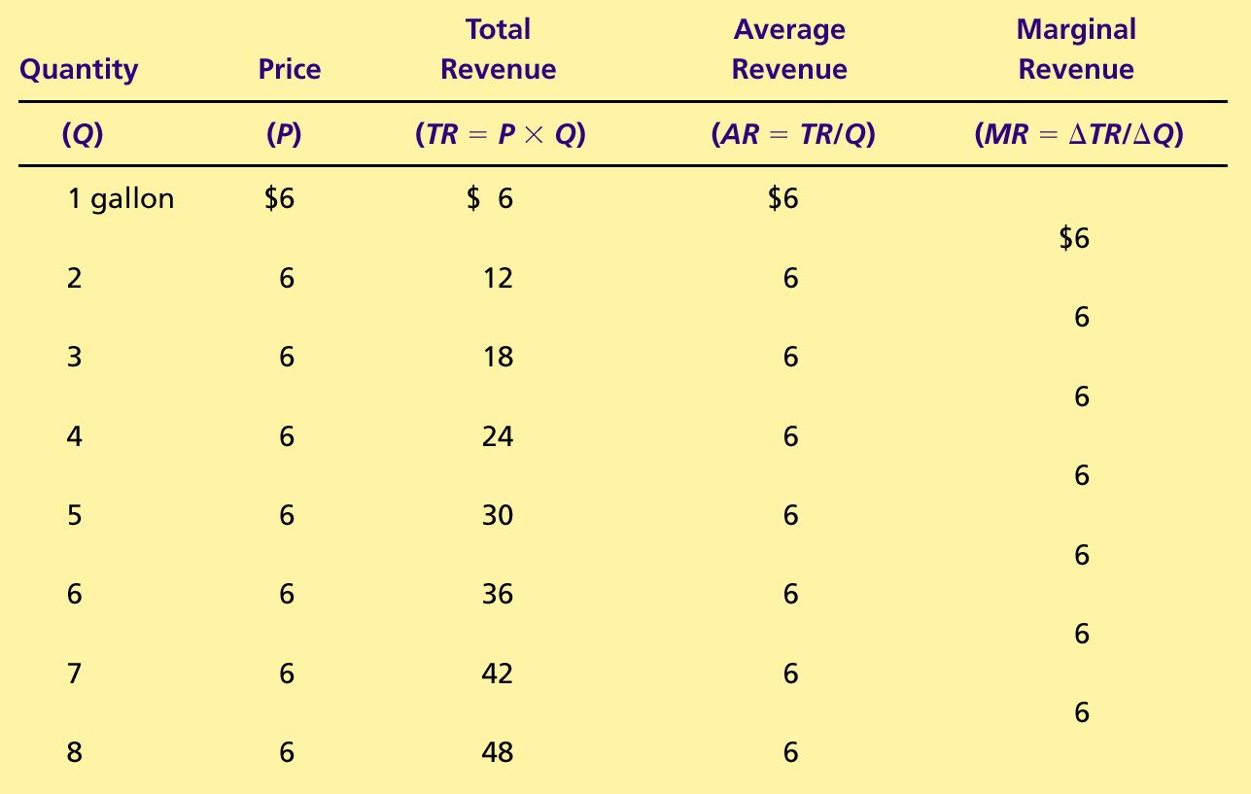
Total Revenue, Average Revenue And Marginal
Revenue For A Perfectly Competitive Firm

Slide 28
PROFIT MAXIMIZATION FOR THE PERFECTLY COMPETITIVE FIRM (SR)
The goal of a competitive firm is to maximize profit.
This means that the firm will want to produce the quantity that maximizes the difference between total revenue and total cost, that is the quantity at which MR = MC.

Slide 29
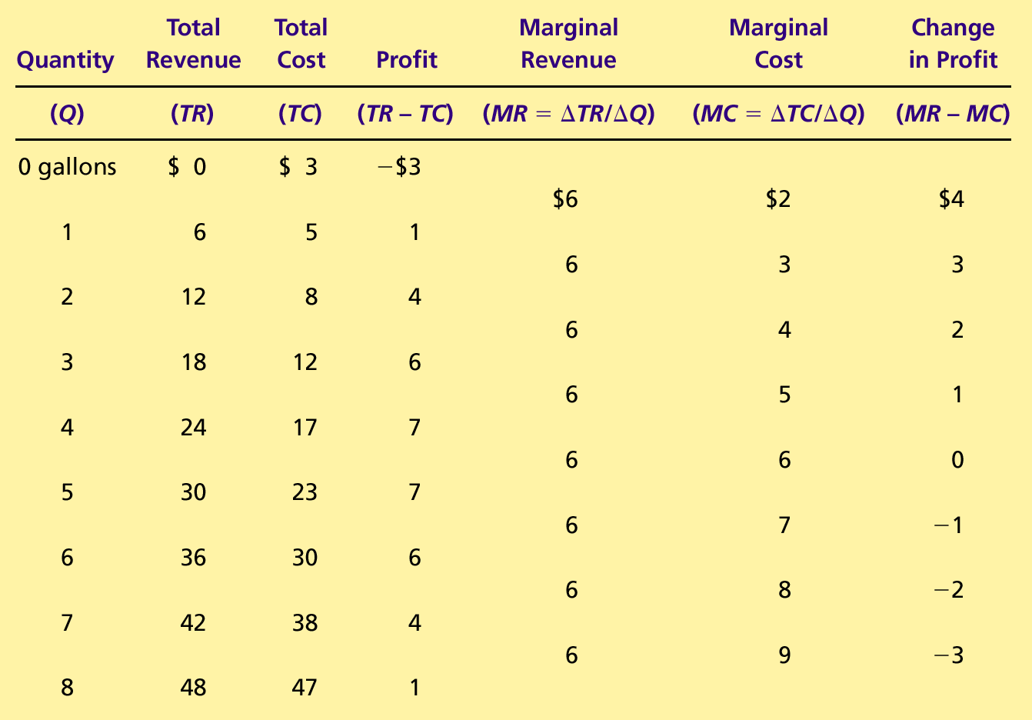
Profit Maximization : A Numerical Example

Slide 30

Profit Maximization for a Competitive Firm (SR)
Costs
and
The firm maximizes
Revenue
profit by producing
the quantity at which
marginal cost equals
MC
marginal revenue.
ATC
P = MR
P
=
AR
=
MR
AVC
0
Q
MAX
Quantity

Slide 31
PROFIT MAXIMIZATION FOR THE PERFECTLY COMPETITIVE FIRM (SR)
Profit maximization occurs at the quantity where marginal revenue equals marginal cost.
When MR > MC, increase Q
When MR < MC, decrease Q
When MR = MC, Profit is maximized.

Slide 32
Marginal Cost as the Competitive Firm’s SR Supply Curve
Price
This section of the firm’s MC
curve is also the firm’s SR
supply curve.
MC
P
2
ATC
P
1
AVC
0
Q
1
Q
2
Quantity

Slide 33
Competitive Firm’s SR Supply Curve
Observations:
  P = MR
  MR = MC
  P = MC
Supply is the amount of output for every possible price. Therefore:
  If P = P₁, then Q = Q₁
  If P = P₂, then Q = Q₂
The portion of the marginal-cost curve that lies above average variable cost is the competitive firm’s short-run supply curve.

Slide 34
The Competitive Firm’s Short Run Decision To Shut Down
A shutdown refers to a short-run decision not to produce anything during a specific period of time because of current market conditions.
Example – 1432 Reliance petrol pumps shut down all over India in 2008. Started reopening gradually after deregulation of petrol and diesel prices 2010 onwards. All reopened by end of 2015.

Slide 35
The Competitive Firm’s Short Run Decision To Shut Down
The firm shuts down if the revenue it gets from producing is less than the variable cost of production.
  Shut down if TR < VC
  Shut down if TR/Q < VC/Q
  Shut down if P < AVC

Slide 36
The Competitive Firm’s Short Run Supply Curve And Shut Down Point
Costs
Firm
’
s short-run
If P > ATC, the firm will continue to produce at a profit.
supply curve
MC
ATC
If P > AVC, firm will continue to produce in the short run.
AVC
Firm
shuts
down if
P
<
AVC
0
Quantity

Slide 37
Competitive Firm’s SR Profits/Losses
In the SR, a perfectly competitive firm can earn economic profits or losses.
In the LR, because of free entry/exit all competitive firms earn zero economic profits.

Slide 38
Short Run Profit As The Area Between Price And Average Total Cost Under Perfect Competition
(a) A Firm with Profits
Price
MC
ATC
Profit
P
ATC
P
=
AR
=
MR
0
Q
Quantity
(profit-maximizing quantity)

Slide 39
Short Run Losses As The Area Between Price And Average Total Cost Under Perfect Competition
(b) A Firm with Losses
Price
MC
ATC
ATC
P
P
=
AR
=
MR
Loss
0
Q
Quantity
(loss-minimizing quantity)

Slide 40
THE MARKET SUPPLY CURVE IN A COMPETITIVE MARKET
Market supply equals the sum of the quantities supplied by the individual firms in the market.

Slide 41
The Short Run Market Supply With A Fixed Number Of Firms
For any given price, each firm supplies a quantity of output so that its marginal cost equals price.
The market supply curve reflects the individual firms’ marginal cost curves.

Slide 42
SR Market Supply with a Fixed Number of Firms
(a) Individual Firm Supply
(b) Market Supply
Price
Price
MC
Supply
$2.00
$2.00
1.00
1.00
0
100
200
Quantity (firm)
0
100,000
200,000
Quantity (market)

Slide 43
Long Run Equilibrium Under Perfect Competition
In the long run, a firm can alter all its inputs, including the size of the plant.
We assume free entry and free exit.
Profits attract entry. Losses make firms exit.
Notes:
78

Slide 44
Long Run Equilibrium Under Perfect Competition
Firms will enter or exit the market until profit is driven to zero.
In the long run, price equals the minimum of average total cost.
At the end of the process of entry and exit, ALL firms that remain must be making zero economic profit.
The process of entry and exit ends only when price and average total cost are driven to equality.
Long-run equilibrium must have firms operating at their efficient scale.

Slide 45
Long Run Equilibrium Under Perfect Competition
Long-run equilibrium of the firm
  all supernormal profits competed away
  LRAC = SAC = SMC = MR = AR

Slide 46
Long-run equilibrium under perfect competition
Profits return
to normal
New firms enter
Supernormal profits
P
Rs
S₁
S_{e}
LMC
LRAC
P₁
AR₁
D₁
P_{L}
AR_{L}
D_{L}
D
O
O
Q_{L}
Q (millions)
Q (thousands)
(a) Industry
(b) Firm
fig

Slide 47
Long-run equilibrium of the firm under perfect competition
Rs
(SR)MC
(SR)AC
LRAC
D_{L}
AR = MR
LRAC = (SR)AC = (SR)MC = MR = AR
O
Q

Slide 48
Why Do Competitive Firms Stay In Business If They Make Zero Economic Profit
Economic profit equals total revenue minus total cost.
Total economic cost includes all the opportunity costs of the firm.
In the zero-economic profit equilibrium, the firm’s revenue compensates the owners for the time and money they spend to keep the business going.
The firms are earning accounting profits.

Slide 49
Exercise
The market demand for a type of carpet known as KP‑7 has been estimated as:
P = 40 ‑ 0.25Q,
where P is price ($/yard) and Q is rate of sales (hundreds of yards per month). The market supply is expressed as:
P = 5.0 + 0.05Q.
A typical(PC) firm in this market has a total cost function given as:
C = 100 ‑ 20.0q + 2.0q².
a. Determine the equilibrium market output rate and price.
b. Determine the output rate for a typical (PC) firm.
c. Determine the rate of profit (or loss) earned by the typical (PC) firm.

Slide 50
A Numerical Example
Given
  P= Rs10
  C(Q) = 5 + Q²
  1) Calculate Optimal Price.
  Calculate Optimal Output.
  Calculate Maximum Profits.

